Slide 1
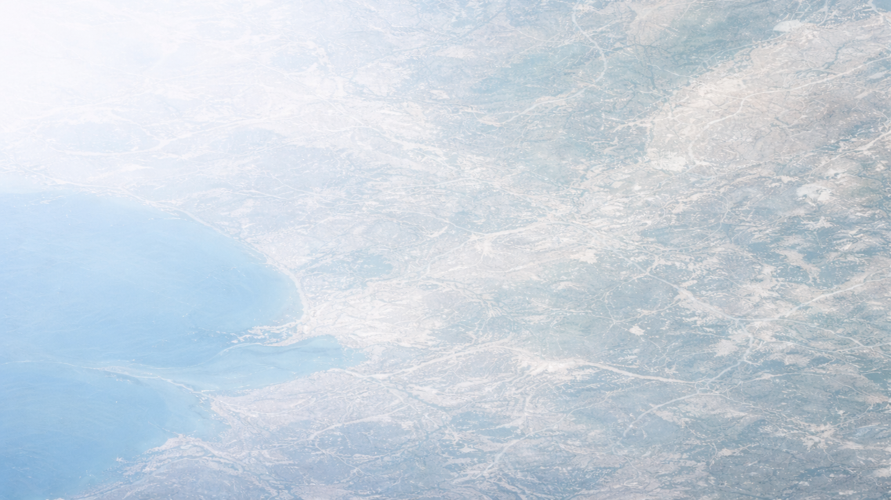




Project Idea
This project builds a Satellite based land use classification system that can identify different land types from satellite images.
Land Types (4 Classes)
Beyond Classification
Here aim was not just Classification. The goal is to build a complete monitoring pipeline that can analyze, explain and visualize land use patterns clearly.
Agriculture
Forest
Urban
Water

Slide 2
How the System Works
Model Training Pipeline
Generated Outputs
Collected Labelled Satellite Images
Confusion Matrix
Prediction Gallery
Misclassification Gallery
Grad-CAM explanation maps
A deep learning model is trained to learn visual patterns of different land types
The model is tested on unseen data to measure accuracy
Model is then applied to larger images by dividing it into tiles and predicting that tile
These predictions are combined to create a land use overlay map

Slide 3
Why This Project Is Different
Most project stop early
What this project adds
Most image classification projects stop at showing accuracy numbers
This project goes beyond that
Visual inspection of correct and incorrect predictions.
Clear analysis of where the model makes mistakes.
Explanation of model focus using Grad-CAM.
Conversion of patch predictions into a full land use overlay map.
A final dashboard that combines all outputs into one view.

Slide 4
Dataset and Class Design
The project works on satellite image dataset that contains multiple land cover categories such as forest, residential areas, rivers, and more
Final Categories
Class Grouping Logic
Instead of directly using all raw classes, they are grouped into four final categories:
Agriculture
Forest
Urban
Water
For example:
Residential, Industrial, and Highway were grouped into Urban.
River and Lake were grouped into Water
Crop related classes were grouped into Agriculture
This mapping was done to make the system practical and aligned with real land monitoring needs.
Agriculture
Forest
Urban
Water

Slide 5
Model and Training Setup
Model Architecture
Training Configuration
The system uses ResNet18 as the core model.
Transfer learning is applied, which means the model already has basic image understanding and is fine tuned for satellite images.
Training setup includes:
Image size resized to 224 by 224
Cross entropy loss
Adam optimizer
7 training epochs
The model achieved around 96% accuracy on the test set.

Slide 6
Evaluation Approach
Evaluation Views
So, I evaluated the model using multiple views:
Confusion matrix to see which classes are confused.
Prediction gallery to visually check results.
Misclassification gallery to study mistakes.
Grad-CAM to understand where the model is focusing.
This gives a clear and honest understanding of how the model behaves, not just how good the numbers.

Slide 7
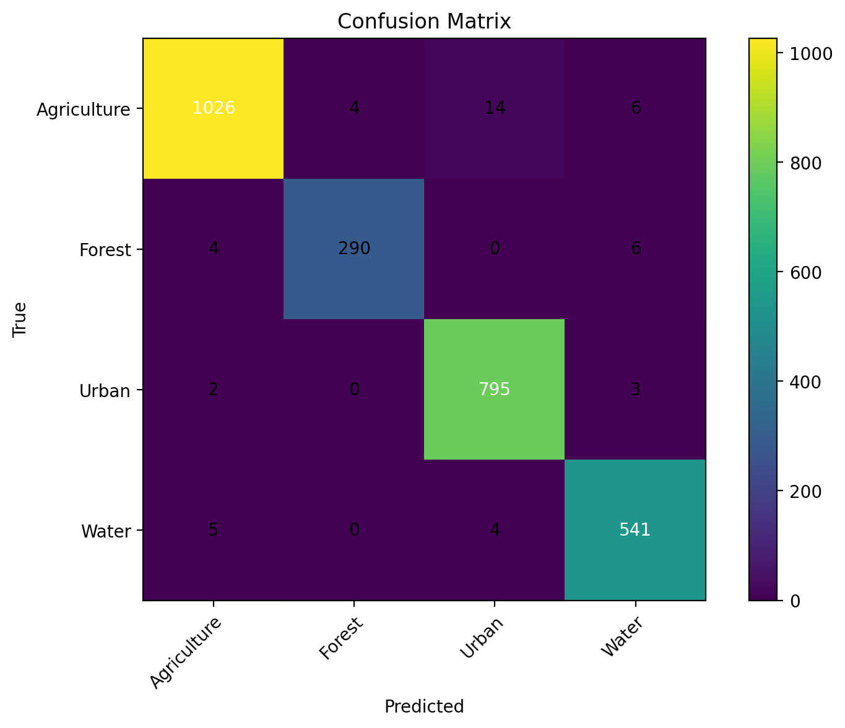
Confusion Matrix Analysis
Model Performance by Class
Agriculture
1026 images correctly classified
Very few confused with Forest, Urban or Water
Strong performance in this category
Forest
290 correctly classified
Small confusion with Agriculture and Water
No confusion with Urban
Urban
795 correctly classified
Very small confusion with Agriculture and Water
No confusion with Forest
Water
541 correctly classified
Very small confusion with Agriculture and Urban
No confusion with Forest

Slide 8
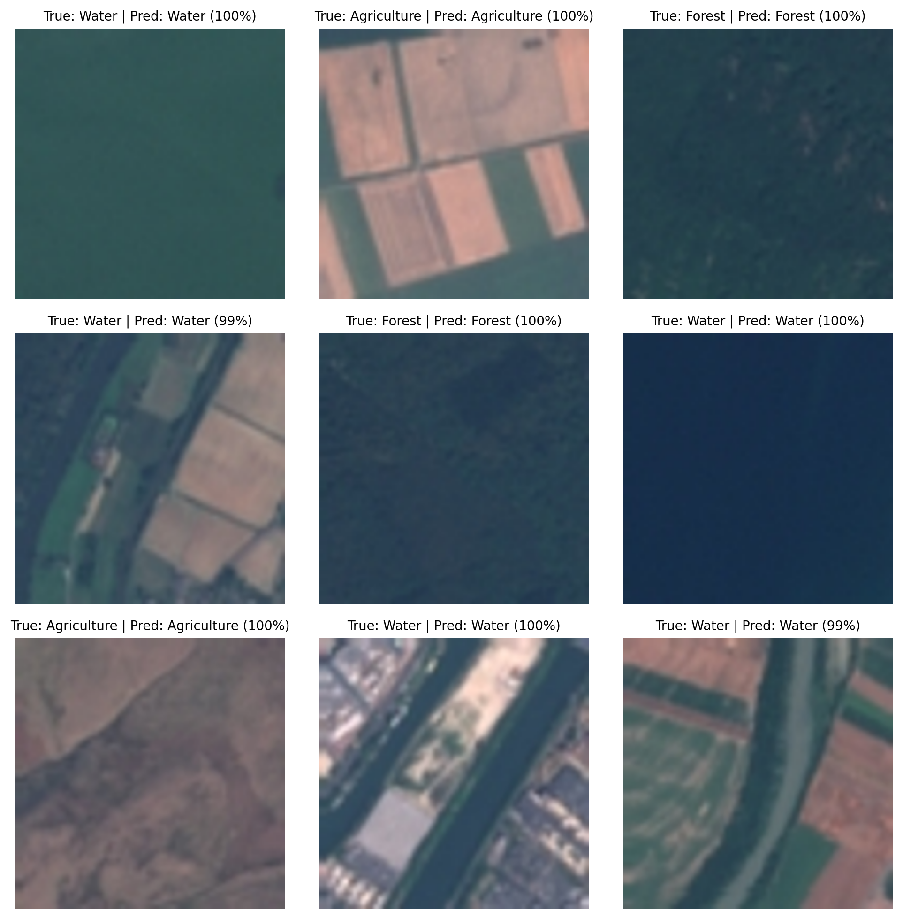
Prediction Gallery
Observations
This image shows test images along with:
True label
Predicted label
Confidence percentage
We can see clear visual patterns:
Water images show large blue regions such as rivers and lakes
Agriculture images show rectangular field patterns
Forest images show dense green texture
All images shown here are correctly classified, which shows that the model can capture the visual patterns clearly, and the confidence values are high, mostly between 96 to 98%.

Slide 9
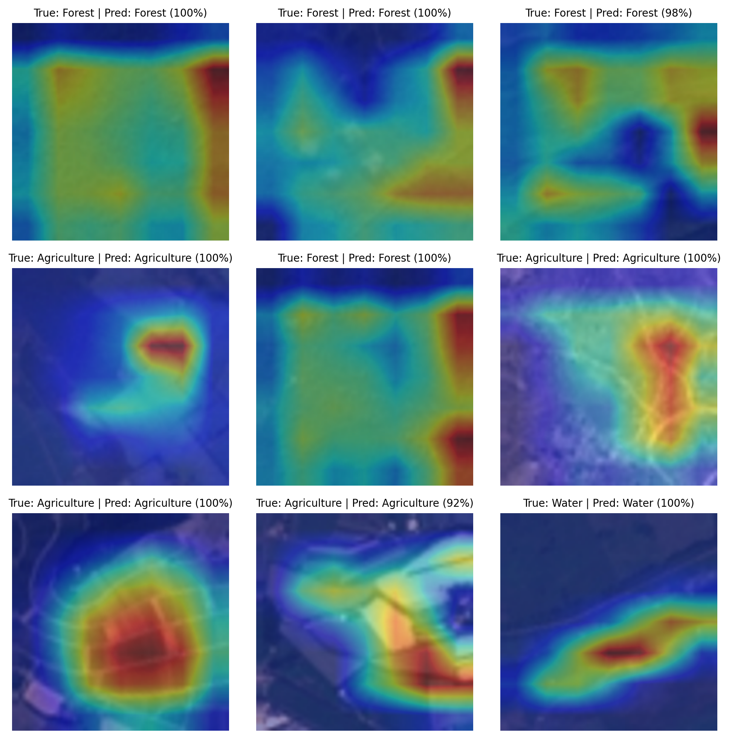
Grad-CAM Visualization
How Grad-CAM Works
Grad-CAM highlights the regions of the image that the model focuses on while making a prediction, where red and yellow areas indicate high attention and blue areas indicate low attention.
From these examples we can observe:
For Forest images, the model focuses on dense green texture areas.
For Agriculture images, it highlights structured field patterns.
For Water images, it concentrates on smooth blue regions.
This shows that the model is not making random predictions but is focusing on meaningful visual regions in the image, and Grad-CAM helps us verify whether the model is looking at the correct areas, which increases confidence in how the system makes its decisions.

Slide 10
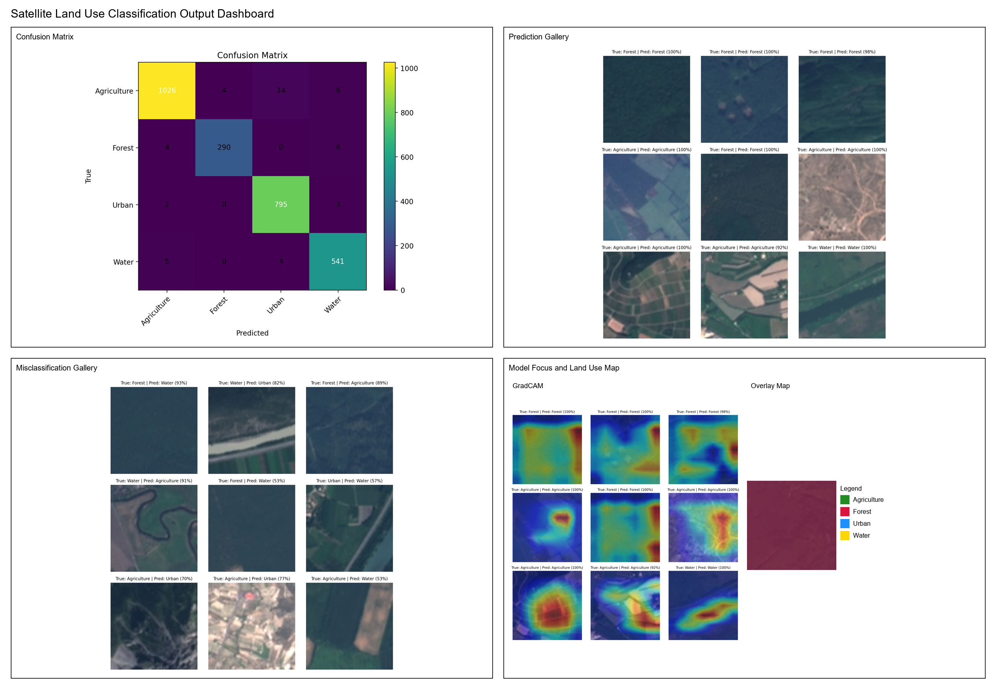
Final Dashboard
This dashboard brings together the confusion matrix, prediction samples, misclassification analysis, Grad-CAM visualizations, and the land use overlay map into one structured view.

